Slide 1

Keep Calm and Kill all
the mutants Introduction to
Mutation Testing
in Python
Paweł Kubiak
<pawel.kubiak@pm.me>

Slide 2
PRESENTATION PLAN / QUESTIONS
How to test to test?
What is the core idea behind mutation testing?
How to use with mutpy?
What are mutation operators?
How mutpy works under the hood?
What are the gains and threats of mutation testing?

Slide 3
WHY TO TEST?
What are the benefits of testing?
Check code correctness
Check edge cases
Ensure business requirements
Document code usage
Painless refactoring
…

Slide 4
HOW TO TEST TO TEST?
How to ensure that our tests are good?
Write tests for them :D
Calculate metrics:
Check total/fail/unstable test count
Measure Code Coverage (or statement coverage, branch coverage)
Use TDD (Red, Green, Refactor)
Mutation testing

Slide 5
BASIC WORKFLOW
TEST ORIGINAL SOURCE CODE
FAIL
DISPLAY
RESULTS / SCORES
NO MORE MUTATIONS
PASS
TAKE ORIGINAL SOURCE CODE
INTRODUCE SINGLE MUTATION
NEW TEST CASE
IS REQUIRED
MUTANT
KILLED
FAIL
EXECUTE
TESTS SUITE
PASS
MUTANT
SURVIVED
INCOMPETENT
EXCEPTION / TIMEOUT

Slide 6
LIVE DEMO
Primality Test
Python
MutPy

Slide 7
LIVE DEMO – MUTPY INSTALLATION

Slide 8
LIVE DEMO – UNIT TESTS IMPLEMENTATION

Slide 9
LIVE DEMO – FUNCTION IMPLEMENTATION

Slide 10
LIVE DEMO – TESTING

Slide 11
LIVE DEMO – MUTATION TESTING
Use experimental mutations
Timeout
Module containing
tests for our function
Colored
output
Module containing our function
Show
mutants

Slide 12
LIVE DEMO – MUTATION TESTING

Slide 13
LIVE DEMO – ANALYZE MUTATIONS

Slide 14
MUTATIONS – RELATIONAL OPERATOR REPLACEMENT
4
sdfdsfs

Slide 15
MUTATIONS – MORE MUTATIONS
ASSIGNMENT OPERATOR REPLACEMENT
CONSTANT REPLACEMENT
ONE ITERATION LOOP
ARITHMETIC OPERATOR REPLACEMENT
sdfdsfs

Slide 16
MUTATIONS – OPERATORS
Standard mutation operators:
- AOD - arithmetic operator deletion
- AOR - arithmetic operator replacement
- ASR - assignment operator replacement
- BCR - break continue replacement
- COD - conditional operator deletion
- COI - conditional operator insertion
- CRP - constant replacement
- DDL - decorator deletion
- EHD - exception handler deletion
- EXS - exception swallowing
- IHD - hiding variable deletion
- IOD - overriding method deletion
- IOP - overridden method calling position change
- LCR - logical connector replacement
- LOD - logical operator deletion
- LOR - logical operator replacement
- ROR - relational operator replacement
- SCD - super calling deletion
- SCI - super calling insert
- SIR - slice index remove
Experimental mutation operators:
- CDI - classmethod decorator insertion
- OIL - one iteration loop
- RIL - reverse iteration loop
- SDI - staticmethod decorator insertion
- SDL - statement deletion
- SVD - self variable deletion
- ZIL - zero iteration loop
sdfdsfs

Slide 17
LIVE DEMO – ADD NEW UNITTESTS

Slide 18
LIVE DEMO – BUGFIXES

Slide 19
LIVE DEMO – FINAL MUTATIONS CHECK

Slide 20
MUTPY – TECHNICAL DETAILS
1. Parsing code into AST (Abstract Syntax Tree)
2. Mutations
3. Code Generation

Slide 21
MUTPY – PARSING CODE

Slide 22
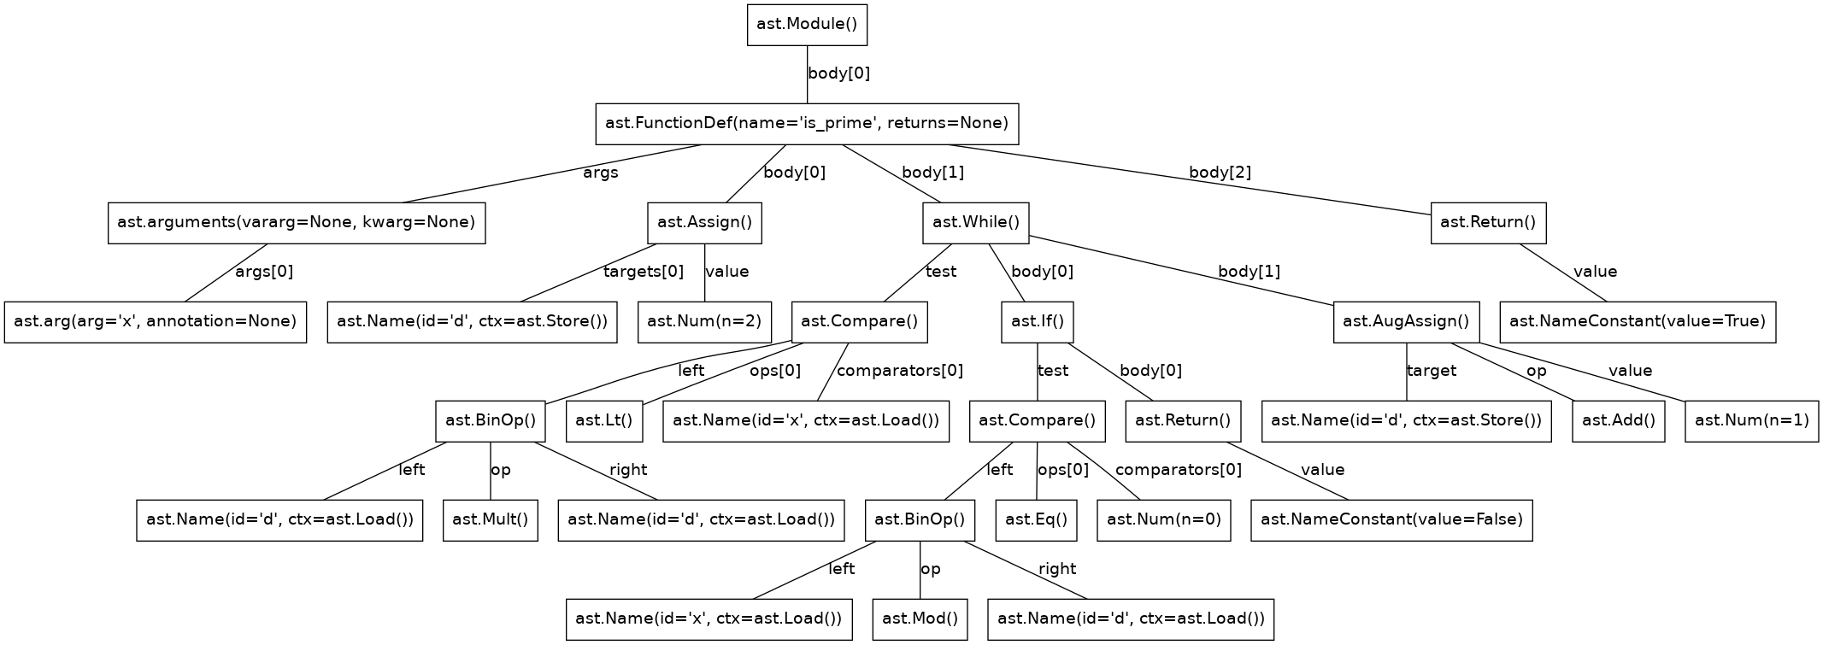
MUTPY – ABSTRACT SYNTAX TREE
github.com/mutpy/astmonkey

Slide 23
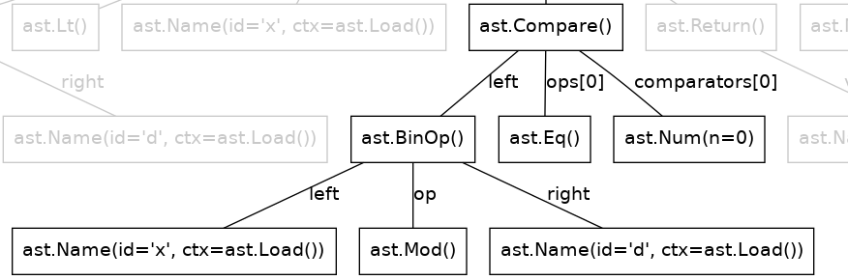
MUTPY – MUTATIONS
ast.Add()

Slide 24
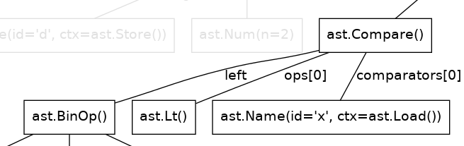
MUTPY – MUTATIONS
ast.Gt()

Slide 25
MUTPY – RUN AND GENERATE

Slide 26
WHY TO MUTATE?
Improving tests suite quality:
Checking edge cases
Prevent common programmers mistakes
Finding unuseful tests
Bugs detection?
"Real” code coverage analysis
Detection of unnecessary code

Slide 27
CHALLENGES – THERE ARE SOOOOOO MANY MUTANTS!
Even simple code can generate enormous number of mutants
What to do?
Run tests in parallel!
Mutate only new/changed code (git maybe helpful)
Run only tests touching mutated code
Mutate on CI server
Test suite speedup – profiling

Slide 28
CHALLENGES – EQUIVALENT MUTANTS
The same functionality can be implemented in many ways
More examples: array summing, collection testing, …

Slide 29
REFERENCES
GOTO 2015 • Mutation Testing in Python • Austin Bingham, https://youtu.be/jwB3Nn4hR1o
Mutants, tests and zombies aka mutation testing with Python and a pinch of Ruby, https://youtu.be/CSncMs50nsw
MutPy is a mutation testing tool for Python 3.x source code, https://github.com/mutpy/mutpy
Analysis of Mutation Operators for the Python Language, A. Derezińska and K. Hałas

Slide 30
THE END ;)
THANK YOU FOR YOUR ATTENTION
www.pawelkubiak.me
pawel.kubiak@pm.me
www.linkedin.com/in/pawel-kubiak
Questions? Mutants?

